Slide 1

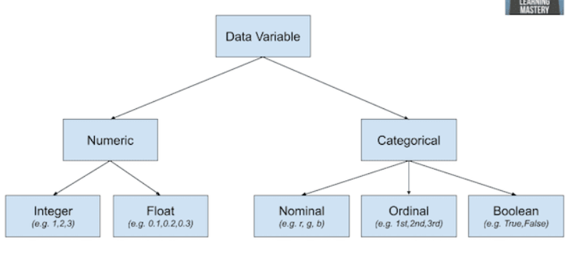
Y = variavel resposta, target, dependente, output X = variável preditora, independente, input

Slide 2
Feature Selection Methods
Unsupervised
Supervised
Wrapper
Filters
Embedded
Hybrid
Drop incomplete features
Drop features with high multicollinearity
Drop features with (near) zero variance
Forward selection
Backyard selection
Recursive Feature elimination (RFE)
Pearson’s
Spearman´s
Anova
Kendall’s
Chi-Squared
Mutual Information
Point-biserial
Linear discriminant analysis (LDA
Lasso/Ridge (using ElasticNet)
Tree based selection
Feature shuffling
Recursive Feature elimination (RFE)
Recursive Feature addition

Slide 3
Explanation
Filter: it is based on correlation, uses statistical measures to assign a score to each feature. This method should be used for preliminary screening. It can detect constant, duplicated, and correlated features. Usually not the best performance in terms of reducing features.
Filter method is less accurate. It is great while doing EDA, it can also be used for checking multi co-linearity in data.
Note: Linear discriminant analysis (LDA): Linear discriminant analysis is used to find a linear combination of features that characterizes or separates two or more classes of a categorical variable.
Wrapper Methods: This approach uses Machine Learning algorithm. Performance of this method depends on model selected and data underlying. Usually can suggests the optimal feature subset. Tries different subset of features to figure out optimal features. Typically very computationally expensive. Can detect interactions between features.
Select a set of features, in which different combinations are prepared, evaluated and compared. A predictive model is used to evaluate the combination of features and assign a score based on model accuracy. Example: Backward Elimination, Forward Selection, Bidirectional Elimination, Exhaustive Search, and RFE (Recursive Feature Elimination). Wrappers are terribly slow when it comes to large datasets.
Embedded Methods: Performs feature selection as building the model. Generally less computationally expensive than Wrapper methods. Often provides results that are best of both worlds, often more realistic approach.
Wrapper and Embedded methods give more accurate results but as they are computationally expensive, these method are suited when you have lesser features (~20).
Hybrid Methods: Amalgamation of all the techniques above. This approach is less computationally expensive than Wrapper methods and has good performance.

Slide 4
Explanation
Qual Método utilizar?
Tente usar o RFE caso tenha recursos computacionais para isso.
Se estiver trabalhando com Classificação e as features forem numéricas utilize f_classif ou mutual_info_classif.
Se estiver trabalhando com Regressão e as features forem numéricas utilize f_regression ou mutual_info_regression.
Caso esteja trabalhando com features categóricas utilize chi2
Automatize essa etapa com Pipelines para evitar erros.

Slide 5
Filter Method: How to select the estimator
Input Variable
Numerical
Categorical
Output Variable
Output Variable
Numerical
Categorical
Numerical
Categorical
Pearson’s
Spearman´s
Mutual Information
Anova
Kendall’s
Anova
Kendall’s
Chi-Squared
Mutual Information

Slide 6
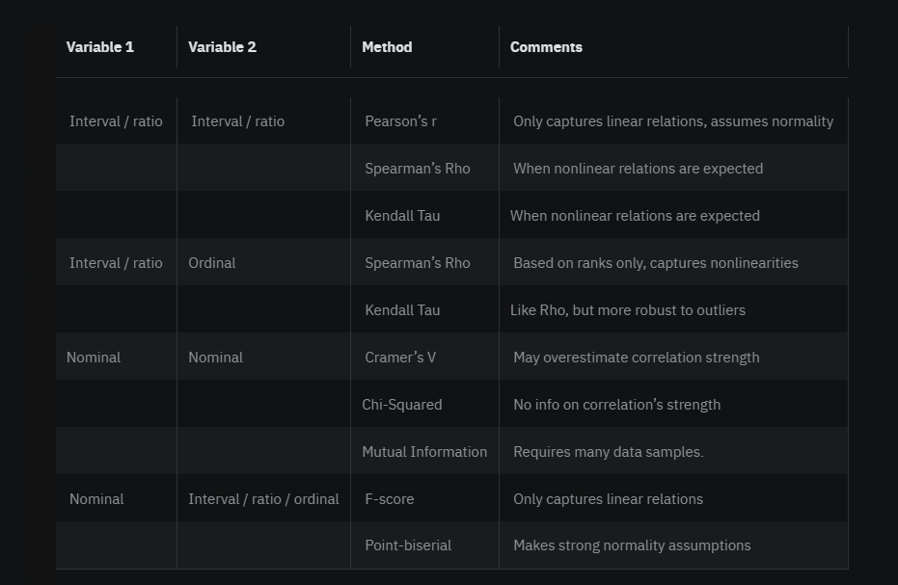

Slide 7
Another scenario is when both variables are nominal. In this case, we can choose from a couple of different correlation measures:
Cramer’s V, which captures the association between the two variables into a number ranging from zero (no association) to one (one variable completely determined by the other).
Chi-Squared statistic commonly used for testing for dependence between two variables. Lack of dependence suggests the particular feature is not useful.
Mutual information a measure of mutual dependence between two variables that seeks to quantify the amount of information that one can extract from one variable about the other.
Cramer’s V is known to overestimate the association’s strength. Mutual information, being a non-parametric method, requires larger data samples to yield reliable results. Finally, the Chi-Squared does not provide information about the strength of the relationship, but rather only whether it exists or not.

Slide 8
Machine Learning
Supervised Learning
Unsupervised Learning
Reinforcement Learning
Classification
Prediction
Clustering
Decision Making
Naive Bayes
Logistic Regression
Decision Tree
Random Forest
Support Vector Machine
K-Nearest Neighbors
Linear Regression
Lasso Regression
Ridge Regression
Neural Network
Support vector regression
Decision tree
K-means
Mean Shift
DBSCAN
Agglomerative Hierarchical
Gaussian Mixture
Q-Learning
R-Learning
TD-Learning

